Slide 1

Problem
Statement
kubeadm-based Kubernetes cluster deployment
Non-admin user deploys & manages Nginx workloads
Constraints & Context
Certificate-based authentication + namespace-scoped RBAC
Reproducible and explainable architecture
01
Notes:
I started this project with a very specific set of constraints, and those constraints drove almost every design decision — especially around identity and access.
The core goal was to deploy a standard Kubernetes cluster using kubeadm, but the real challenge was making sure a non-admin user could deploy and manage their workloads safely. That meant relying on certificate-based authentication and strictly namespace-scoped RBAC.
This wasn’t just about getting something running. The solution needed to be reproducible, explainable, and easy to reason about — both from a security and an operational perspective. That focus on clarity and least privilege shaped the entire architecture.
To support that goal of reproducibility, I also scripted the installation as much as possible. That includes standardizing the host configuration — things like kernel and cgroup settings — so the cluster behaves predictably and avoids common kubeadm incompatibilities.
The intent wasn’t deep OS tuning, but reducing environmental drift and eliminating an entire class of setup issues before they show up as problems later.
Now I’ll walk through how the cluster is structured.

Slide 2

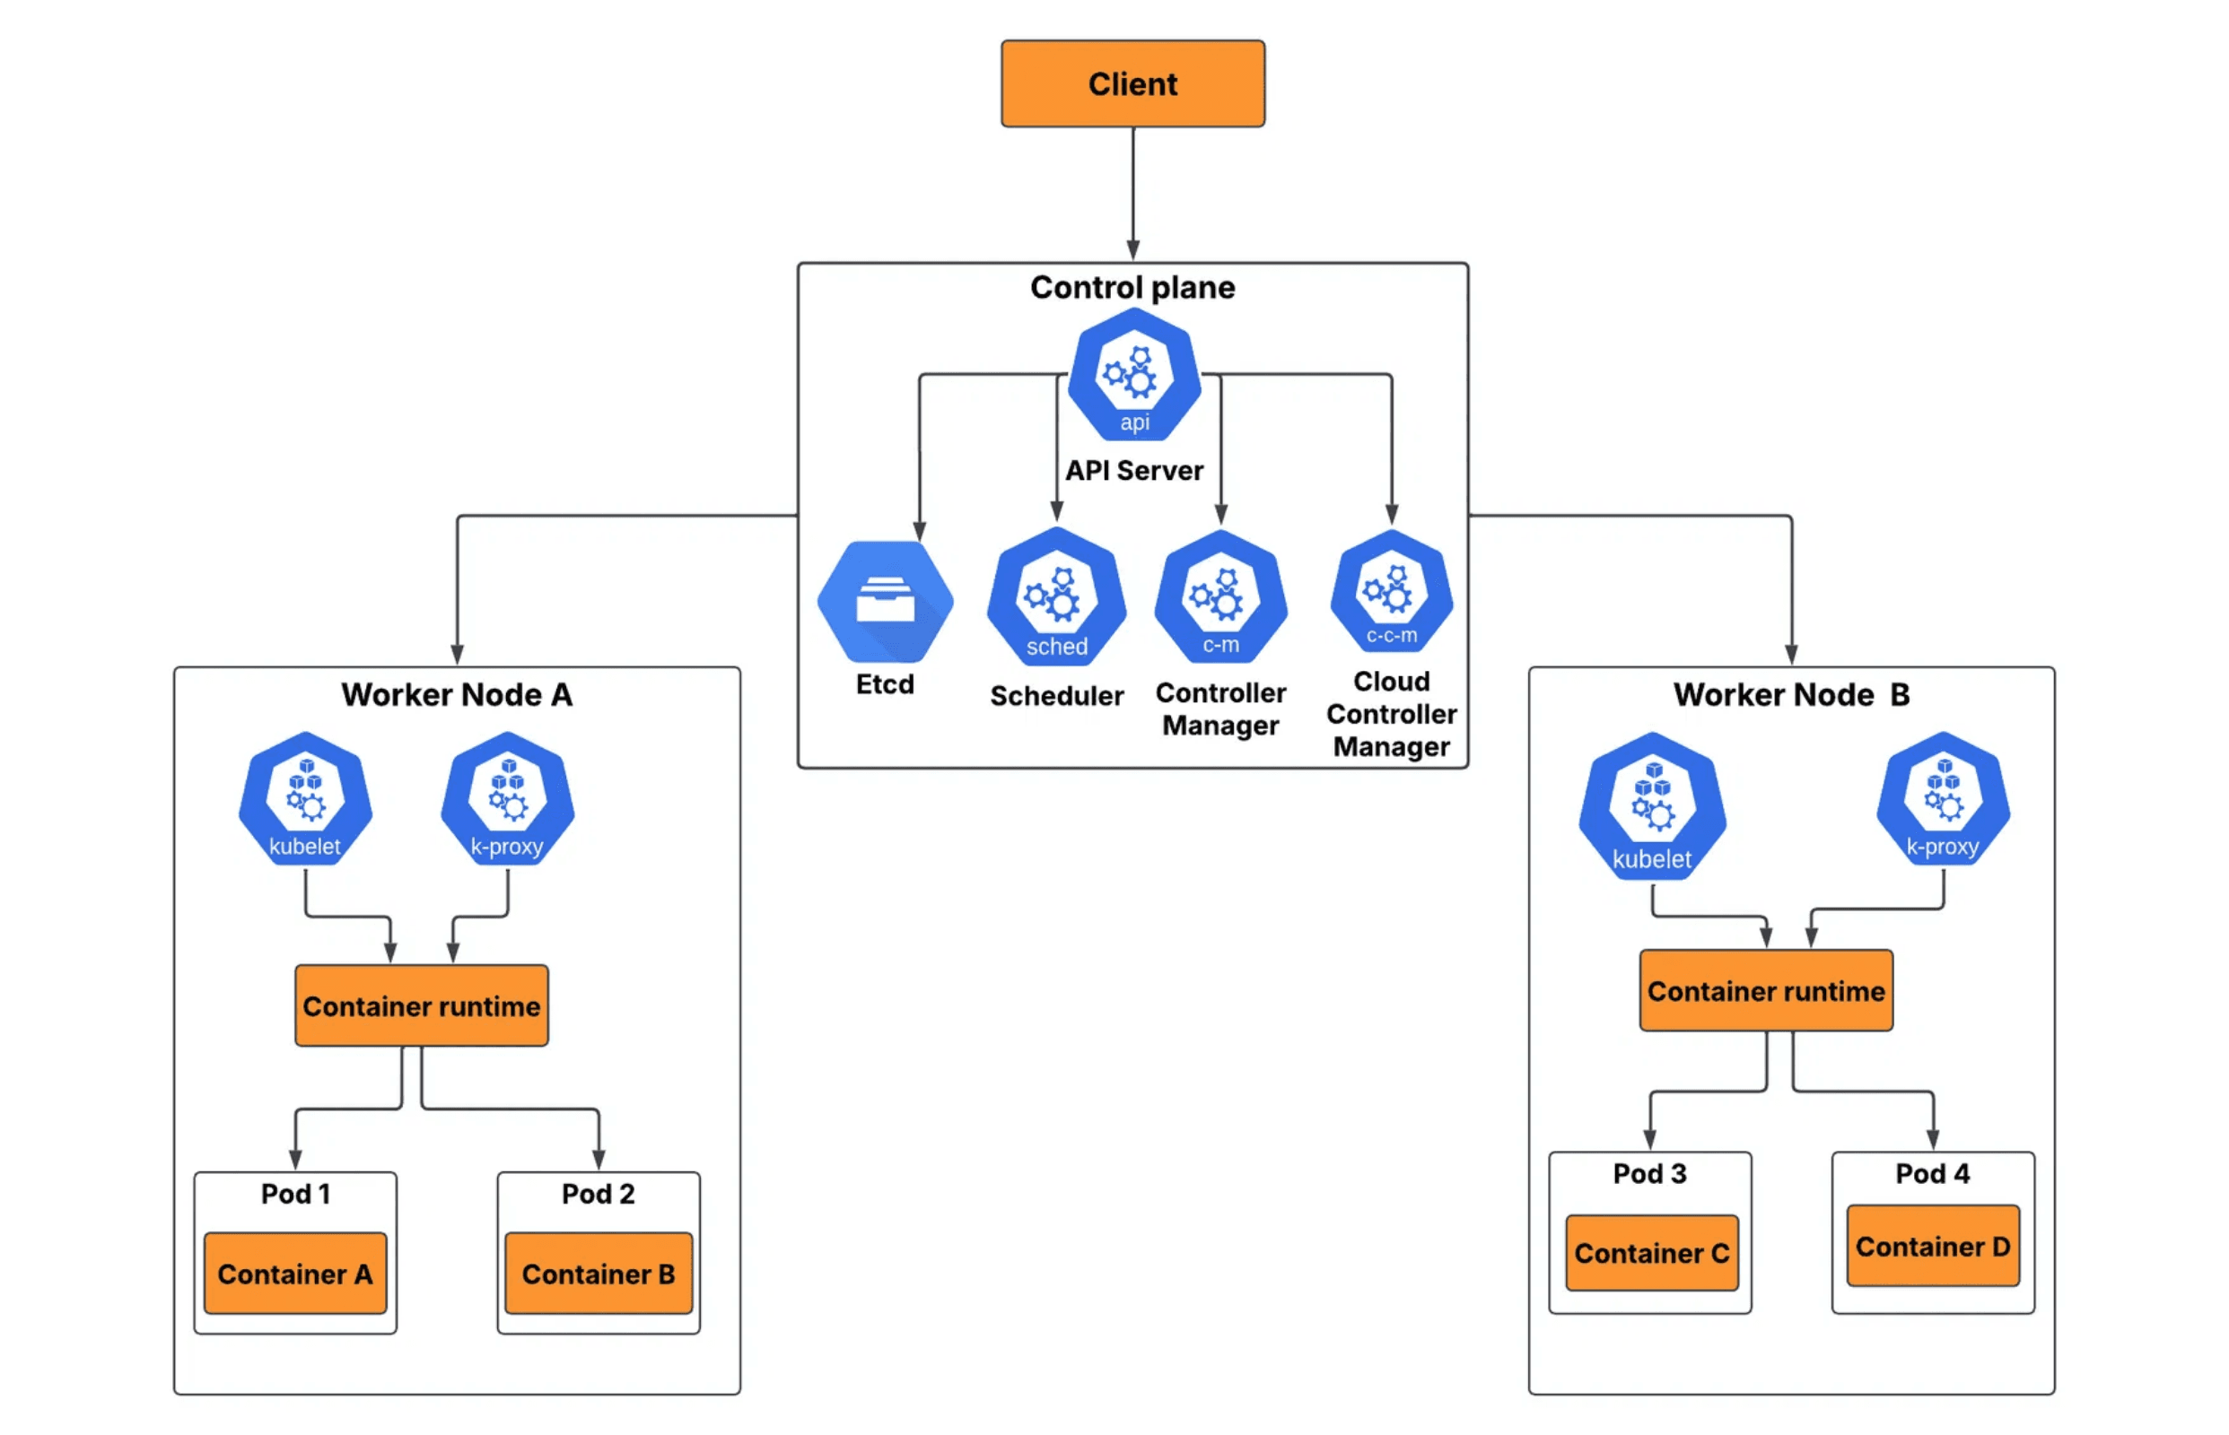
Architecture Overview
01
1 control plane node, 2 worker nodes topology
02
Standard Kubernetes primitives only — no custom operators
03
Explicit identity → RBAC → namespace mapping workflow
04
Clean, upstream-aligned design with no hidden complexity
02
Notes:
The architecture itself is intentionally simple. I kept this very close to upstream Kubernetes, so there’s nothing magical happening under the hood.
The cluster follows a standard topology — one control plane and two worker nodes — and uses only native Kubernetes primitives. One important call-out is that the control plane is intentionally not redundant. That was a deliberate tradeoff to keep the focus on access control, identity, and operational clarity rather than availability mechanics.
The key idea here is that the security model is explicit and easy to reason about: identity maps to RBAC, and RBAC maps directly to a namespace. That clarity is what makes the system auditable, predictable, and supportable over time.
With that foundation in place, the most important question becomes how users actually get access to the cluster.

Slide 3

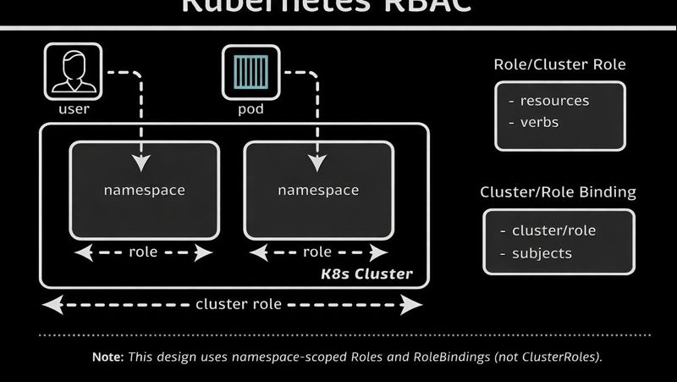
How Users Access
Security Model
01. Authentication
X.509 certificate-based authentication establishes strict user identity.
02. Onboarding
Certificate Signing Request (CSR) approval flow ensures verified entry.
03. Authorization
Namespace-scoped RBAC bindings limit blast radius.
04. Restriction
No cluster-admin access. Principle of least privilege is enforced by default.
03
Notes:
This slide covers the core of the security model — how users are identified and how their access is enforced.
Everything starts with strong authentication. Users authenticate to the cluster using X.509 certificates, which gives us a cryptographically verifiable identity that Kubernetes natively understands.
User onboarding is handled through the Kubernetes Certificate Signing Request, or CSR, workflow. That means every user identity is explicitly requested and explicitly approved before it becomes valid. Kubernetes itself acts as the identity broker here.
Once a user is authenticated, authorization is enforced through namespace-scoped RBAC bindings. This is where the principle of least privilege is applied. No user receives cluster-admin access — their permissions are limited strictly to the namespace they operate in, which defines their blast radius.
At a high level, creating a user follows a very explicit workflow. First, a namespace is created to establish the user’s operational boundary. A private key and certificate signing request are generated for the user and submitted to the Kubernetes API. That request must then be explicitly approved, which acts as a clear trust gate.
Once the identity exists, it’s bound to a namespace-scoped role that defines exactly what actions the user can perform. Finally, a kubeconfig is generated that ties together the user identity, the cluster, and the namespace. Before handing that off, permissions are validated to ensure they behave exactly as expected.
This identity-to-RBAC flow is the backbone of the security posture. It’s explicit, auditable, and easy to reason about when something goes wrong.
That said, this approach isn’t perfect, so the next thing to talk about is where the rough edges and operational limits start to appear.

Slide 4


Tradeoffs &
Sharp Edges
01
02
Manual cert lifecycle doesn't scale beyond small teams
RBAC complexity grows exponentially with users
03
04
kubeconfigs are operationally fragile & risky
Auditability is limited out-of-the-box
04
Notes:
This is where the limitations of the current design start to show. While the model is secure and easy to reason about at small scale, it does have some sharp edges operationally.
The biggest challenge is certificate lifecycle management. With client certificates, rotation and expiration are manual unless you build automation around them, and that approach doesn’t scale well beyond a small number of users.
RBAC complexity also grows quickly as you add more users and namespaces. Even with good conventions, managing roles and bindings becomes increasingly difficult to reason about over time.
Kubeconfig distribution is another weak point. These files are portable, but that also makes them easy to misconfigure, mishandle, or lose, which creates operational risk.
Finally, while Kubernetes provides basic auditing, it’s limited out-of-the-box. Gaining clear visibility into who accessed what, and when, requires additional tooling.
These are the kinds of real-world operational challenges that inform what I’d want to improve next.

Slide 5


Next
Iterations
01 // GITOPS
02 // IDENTITY
App Lifecycle
Automated Rotation
Adopt GitOps workflows (ArgoCD, Flux) for consistent application delivery.
Replace manual processes with automated identity and certificate rotation.
03 // VISIBILITY
04 // ARCHITECTURE
Audit & Access
Separation of Concerns
Implement stronger audit logging and granular access visibility tools.
Enforce clear boundaries between platform infrastructure and application layers.
05
Notes:
Looking ahead, the next iterations focus on reducing operational burden and increasing visibility.
First, I’d move application delivery to a GitOps workflow using something like ArgoCD or Flux. That shifts application lifecycle management out of manual processes and makes deployments consistent, auditable, and reversible.
Identity is the next big area. Certificate issuance, rotation, and revocation need to be automated to remove the manual overhead and reduce the risk of stale credentials.
Visibility is the other major gap. Stronger audit logging and access visibility would give us a clear view into who accessed the cluster, what actions they took, and when.
Finally, I’d make the separation between platform and application responsibilities explicit and enforced. Platform teams would own cluster infrastructure, identity, and access policies, while application teams would own deployments within clearly defined boundaries. That removes ambiguity and prevents accidental privilege creep as the system grows.
With that context in place, I’ll switch over to the demo.

